Slide 1
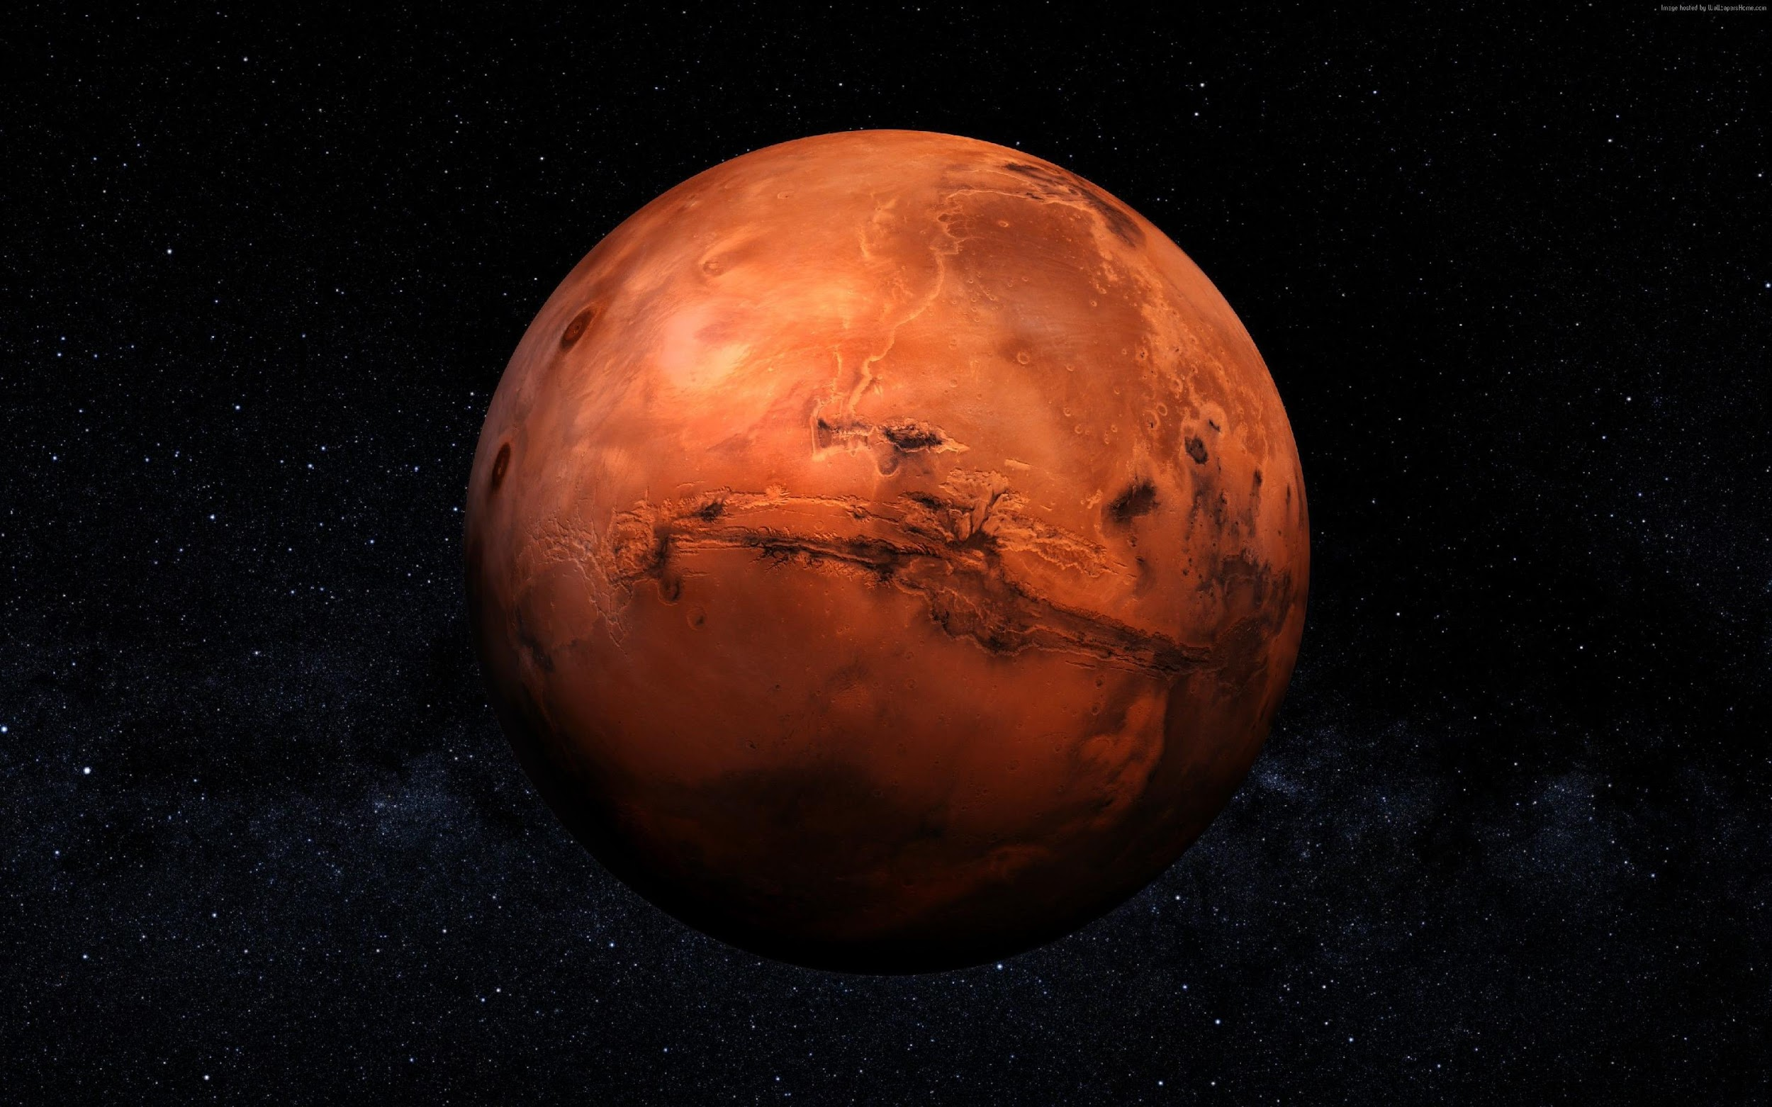

MARS
NALITY
Notes:
We are marsonality

Slide 2
MARS
NALITY
Notes:
We as Marsonality help curious and insecure people to become a better version of themself by giving them the opportunity to change their personality.

Slide 3

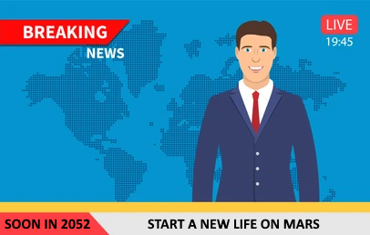
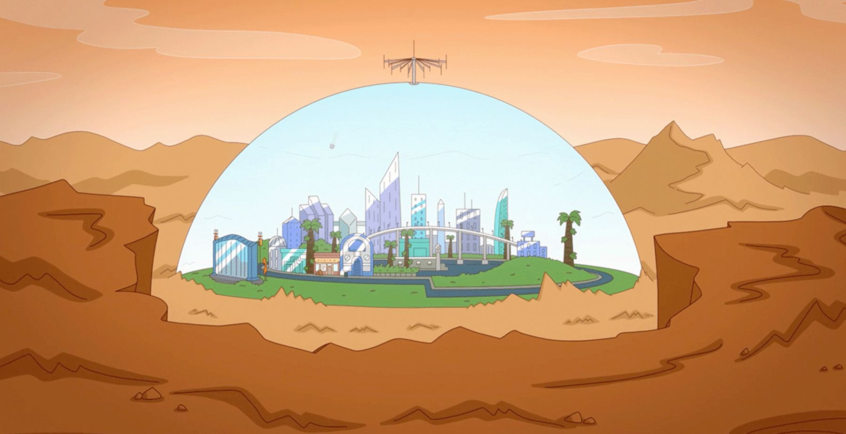
MEET BOB
Commercial: colony on Mars
Effort and perseverance
Loss of courage, feeling alone, … Job?
Find a solution!
Notes:
Story
(TUUR) Meet Bob.
It is 2051, Bob is quietly watching the News and discovers a commercial for traveling to Mars in exactly 1 year. A colony there has been preparing to expand their settlement.
As curious as he is, he decides to seize this opportunity and embark on a new life.
Eventually the time comes, Bob heads off on a high-speed rocket flight to the space station where he has himself officially identified as a Martian.
Soon it becomes clear to Bob that it will take a lot of effort and perseverance to get to know all that is new and therefore unknown.
After a few days, Bob begins to lose courage, feeling alone, different and "too little" because all the other residents are much more intelligent. Looking for a job is not easy either, the only available and relatively well-paying job is working in mines, but Bob has a great fear of small spaces... He must and will find a way to solve all these problems because he wants to stay on Mars!

Slide 4
THE PROBLEM
WE ARE NOT READY FOR MARS
and neither are you…
Notes:
(JASPER)
We are not ready for mars, and neither are you…
NEXT SLIDE

Slide 5

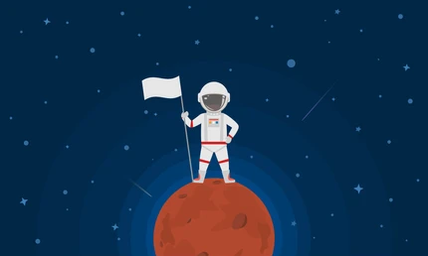
THE PROBLEM
Bombarded with the new world > pressure
The best
Simple humans
Notes:
(JASPER)
Just imagine, when you land on Mars, you are bombarded with the new experience of the new world. New biome, new air, new people, laws and technologies.
The pressure will be overwhelming and potentially damaging to the mental health of simple Earthlings on Mars.
The new world requires people to be at their best, keeping up with the growth of technology. Unfortunately, humanity does not always succeed as efficiently as we wish.
We, simple humans with emotions and feelings, have trouble enough regulating our reactions to new undiscovered things, even in our own homes.
So, in a nutshell:
Moving to a new planet is a great challenge for our simple minds and bodies. This needs an ingenious invention to make it more bearable.

Slide 6
THE SOLUTION
THE “YOU” IN YOU, CAN BE BETTER
there’s no need for shortcomings
Notes:
(Daan)
The you in you, can be better and we will accomplish this with a futuristic development where software combined with hardware takes control of a person's character attributes.
NEXT SLIDE

Slide 7

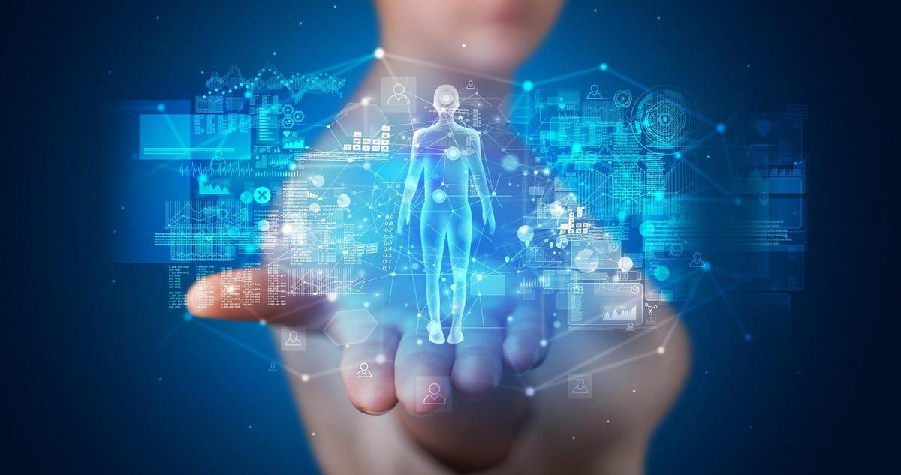
THE SOLUTION
A “chip”
Initial scan, in depth character
Satisfied?
Notes:
(Daan)
We as Marsonality want to be able to provide every inhabitant of Mars with a "chip" giving them knowledge of who they actually are through an initial scan. This chip will be injected into the back of the head when opening an account with us.
Now you finally find out about your character in depth. After this, it may turn out that you are not satisfied with certain traits and want them gone? Or maybe you want more of them?
This is possible with the software that we create and we will now explain how it generally works.

Slide 8
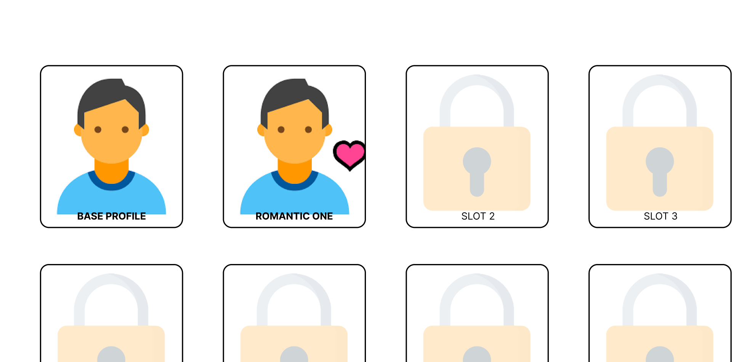
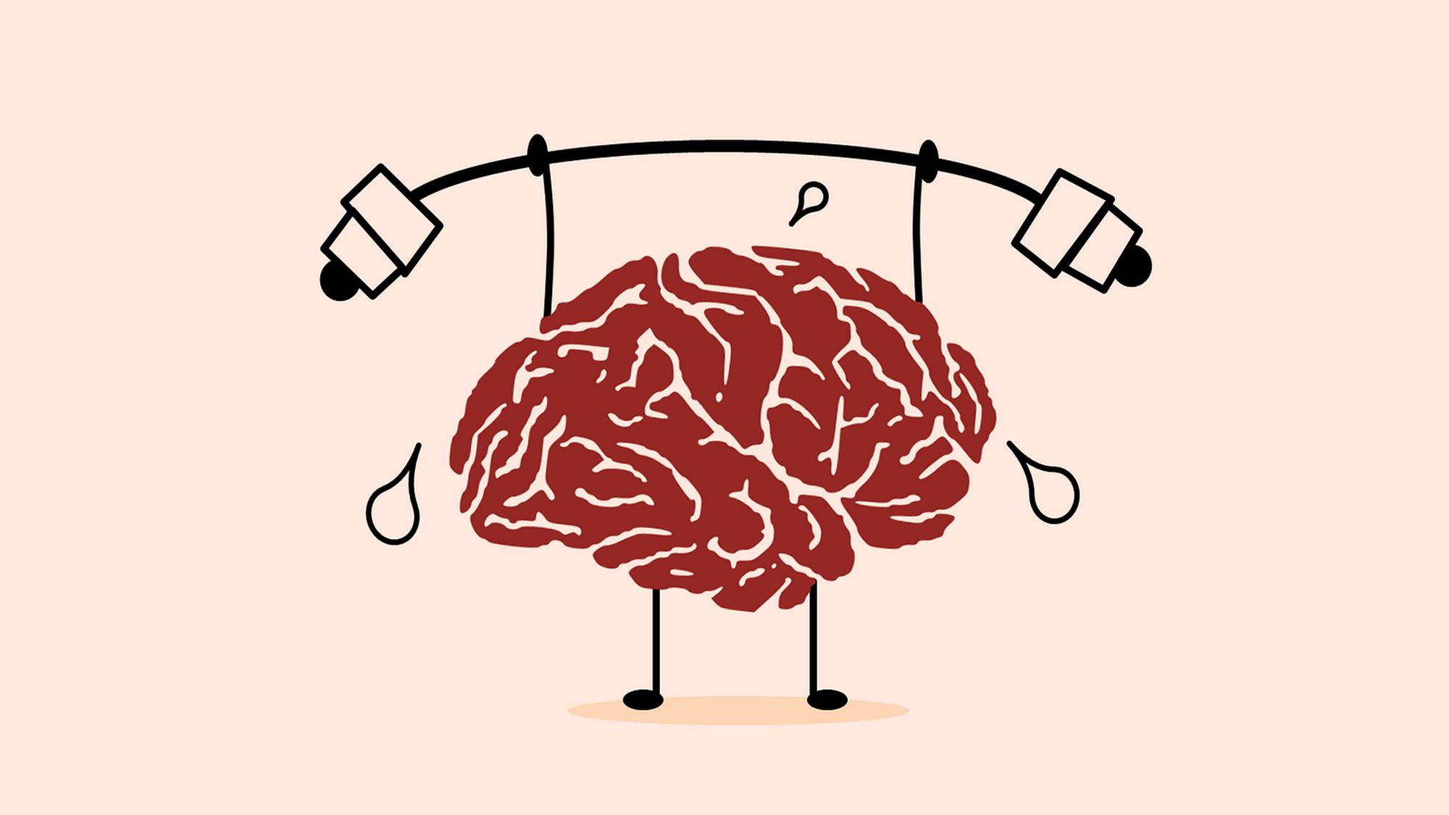
THE SOLUTION
Basic profile (dashboard x interactive device)
Purchase profiles (locks)
Hungry?
Original you
Cooldowns
Notes:
(JB)
Each resident can sign up with us to create a basic profile.
Hereby the person gets the opportunity to consult their personal dashboard linked to his/her/theirs MarsID through their interactive device.
If desired, one can purchase multiple profiles which contain a number of fixed "locks" that are parallel to the number of personal traits they can customize.
Please note that profiles can only be purchased in ascending order, starting with one unlockable trait and getting more unlocks with more profiles you purchase, we do this to keep people from getting too hungry for more.
Simply 1 more personal attribute can have an immense impact on a person.
(K)
But what if you want to go back to the original version of yourself?
That is possible, we keep your initial first personality scan as a return point.
You may wonder if one can just change personalities at any time, well no one can do.
When one configures a profile,meaning, they pick the traits and lock them in, there is a cooldown period of 24 sol before changing them, and changing between profiles has a cooldown period of 5 sol.

Slide 9
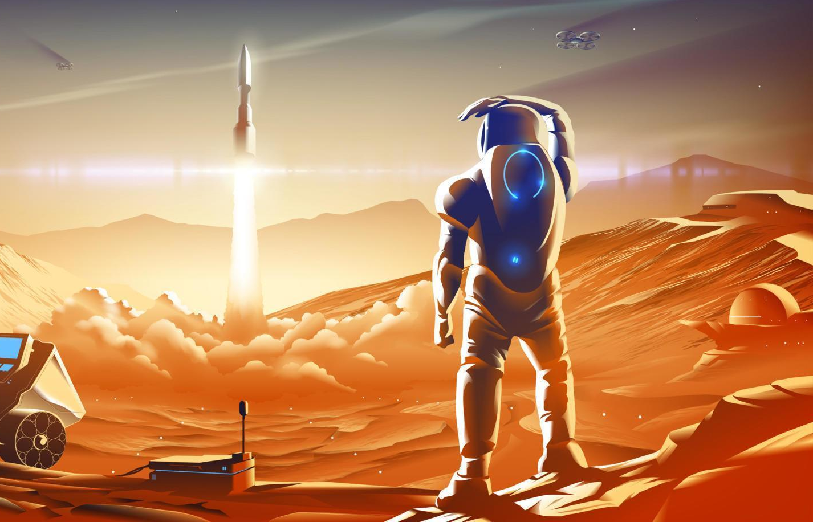
THE SOLUTION
Leaving Mars
Deactivating
Notes:
(Daan)
When someone decides they want to leave Mars, to go live somewhere else or just to go on a holiday, they will have to deactivate their chip at the space station. We intend to let the users do this themselves via the software on their wristband.
If someone were to try to leave Mars without deactivating, the chip would deactivate on its own when leaving of the planet. Also, our software would notify us and the user would be warned that if this happens more than once, they will be fined 50 marscoins.

Slide 10
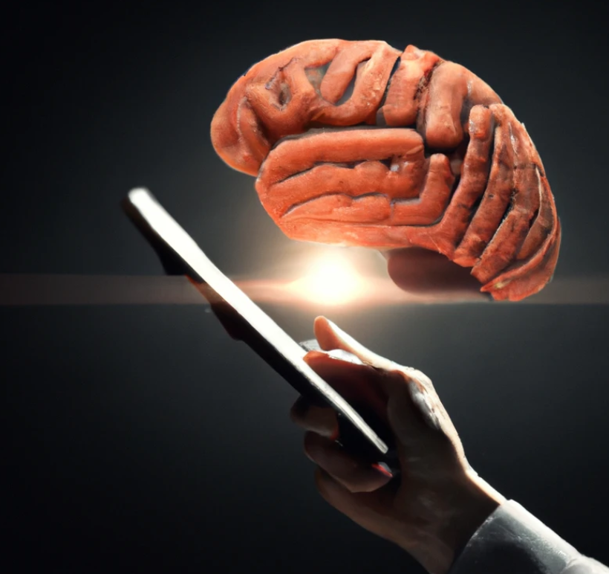

VALUE
Investment: research
Business model
Limited knowledge
R & D
Notes:
(K)
If you are curious about how our company will pay off as an investment, then we are happy to point out that this research into the human psyche will be closely tied in with intrinsic need to learn more about ourselves as a species, as well as expanding the abilities of our brains through development and adjustment of our human traits.
(K)
There is no end to perfection, and the more we learn the more we want to know, so our business model is guaranteed to have an exponential growth given an initial investment. We plan to invest heavily into research of the human psyche and how it will adjust on the new planet as well as development of features, mods and more extensive profiles for additional traits.
(JB)
The limited knowledge we have on traits will give us a head start on our research to expand on what our brains and bodies are capable of.
With the help of research and development we will be able to see if these traits are adjustable on a genetic level. Imagine the possibilities and height we could reach then!
Eventually the company will look into acquiring smaller companies to have multiple departments of focus.

Slide 11
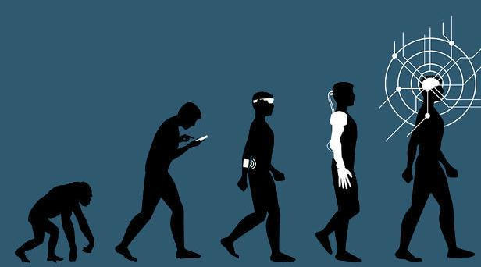
END
MARS IS FUTURE, WE WANT YOU TO BE PART OF IT
ARE THERE QUESTIONS?
Notes:
(TUUR)
MARS IS FUTURE, WE WANT YOU TO BE PART OF IT, THANKS FOR YOUR ATTENTION

